Slide 1

FIRE DETECTION SYSTEM USING ESP32 MICROCONTROLLER
Student : Nguyen Song Nam - 20210621
Do Van Doan - 20213607
Nguyen Viet Hung - 20213614
Instructor : Dr. Ngo Vu Duc

Slide 2
Contents
1
INTRODUCTION
2
LIST OF COMPONENTS
3
FINITE STATE MACHINE
4
ZIGBEE NETWORK
5
OPTIMIZE ENERGY WITH ESP32 SLEEP MODE
6
RESULTS

Slide 3

INTRODUCTION
1.1
PROBLEM
- Fire , commonly known as fire , explosion , electrical short circuit in crowded places, such as multi-storey apartment buildings
* Cause of fire :
Electrical faults
Human Negligence
Natural Causes
Mechanical Failures

Slide 4
INTRODUCTION
1.2
DEFINE THE PROBLEM
Sensors
Three Floors
Zigbee
relay
SYSTEM
Energy saving mode
Practical
Problem
- FSM

Slide 5
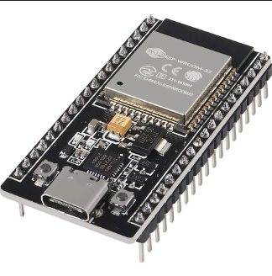
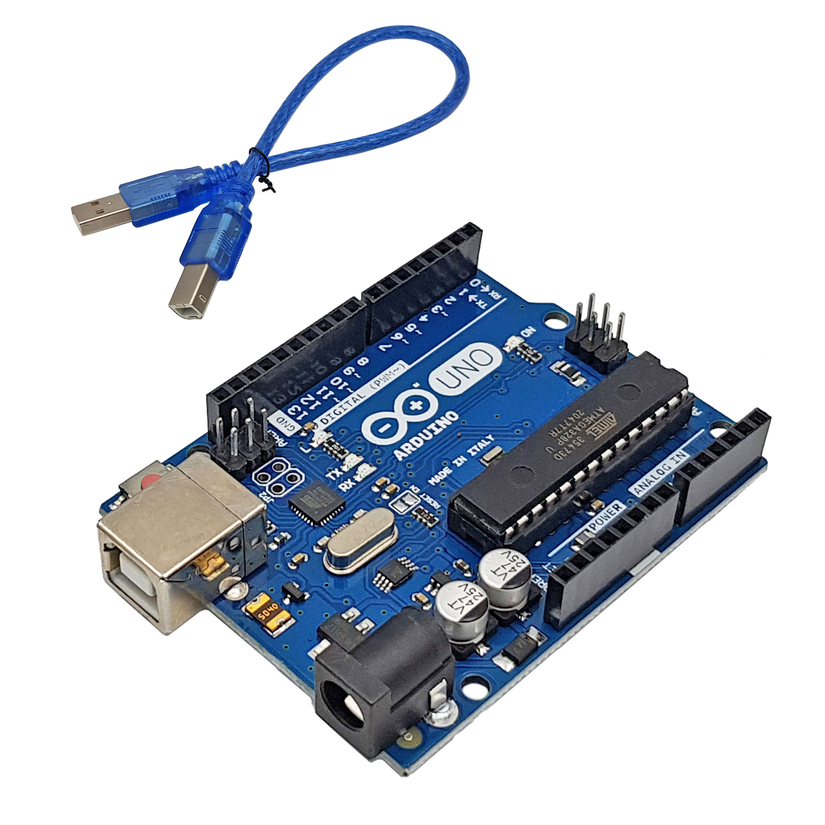
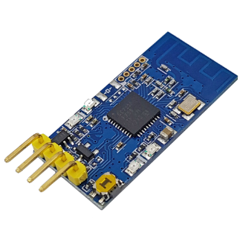
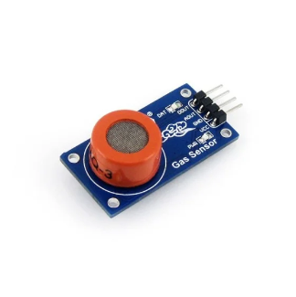
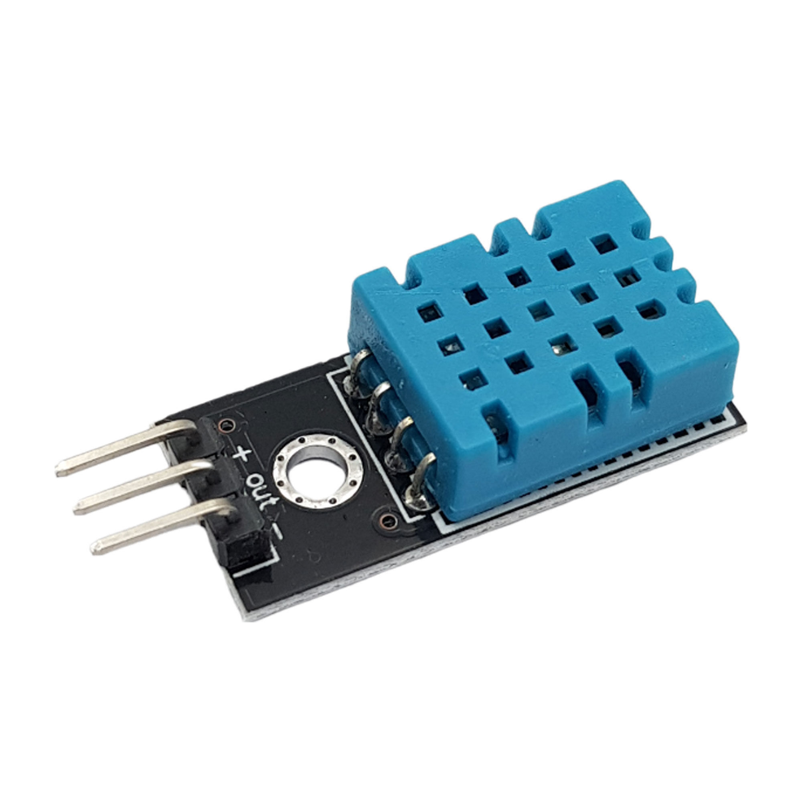
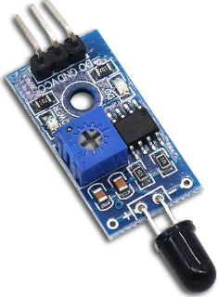
LIST OF COMPONENTS
ESP32 microcontroller
Arduino Uno R3 board
Module RF Zigbee CC2530
Temperature and Humidity sensor DHT11
Smoke sensor MQ-3
Flame sensor
Fire alarm
Leds represent for water injection system

Slide 6
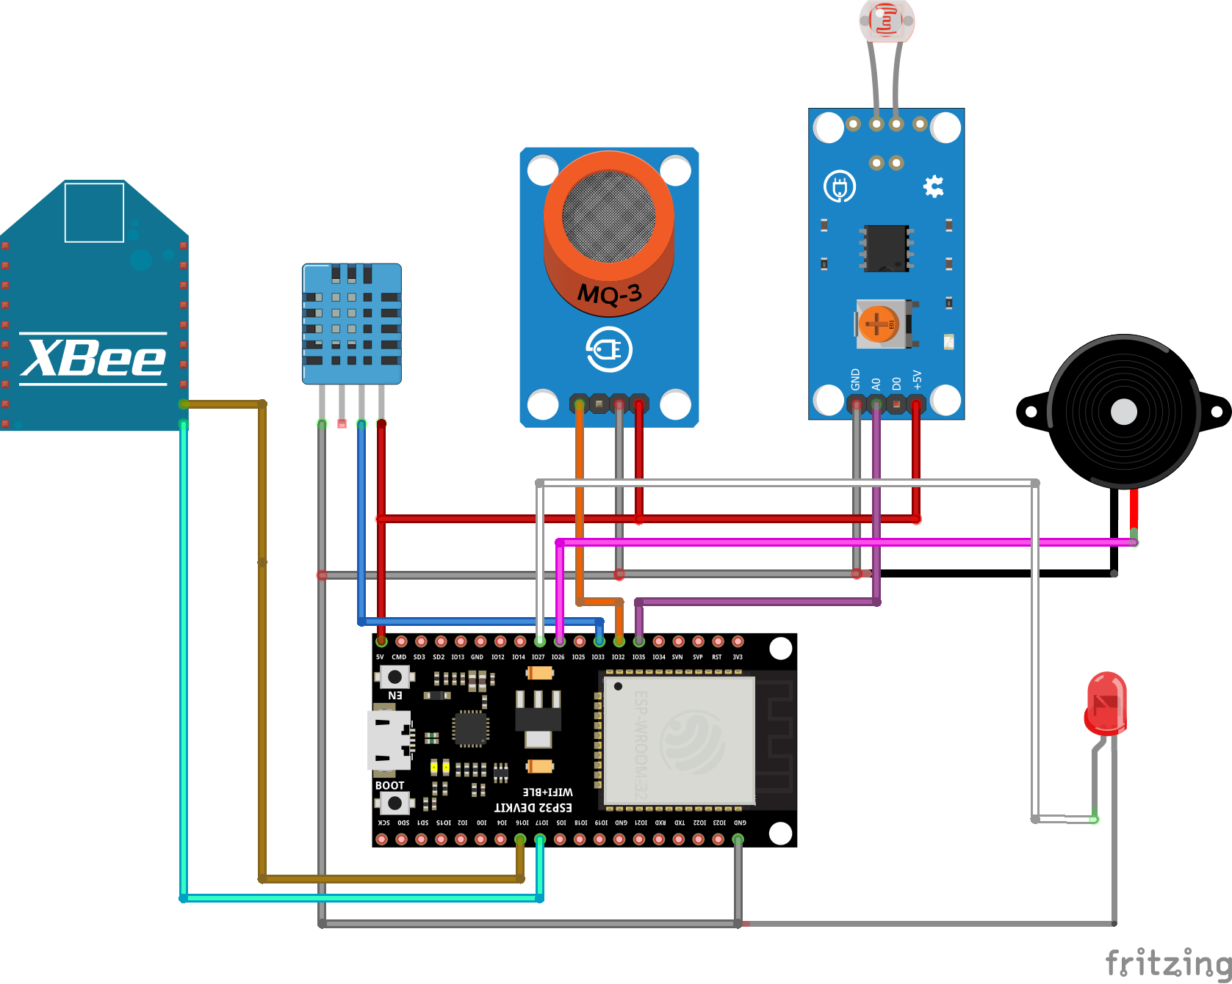
SCHEMATIC OF FLOOR 1

Slide 7
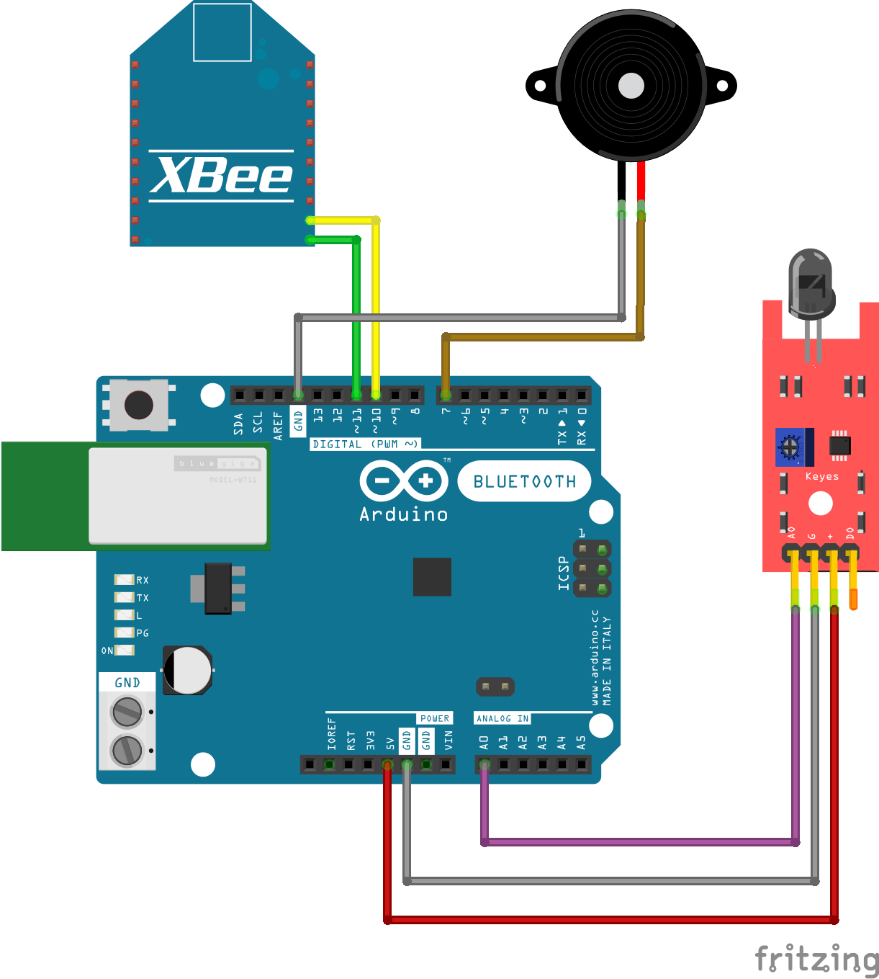
SCHEMATIC OF FLOOR 2, 3

Slide 8
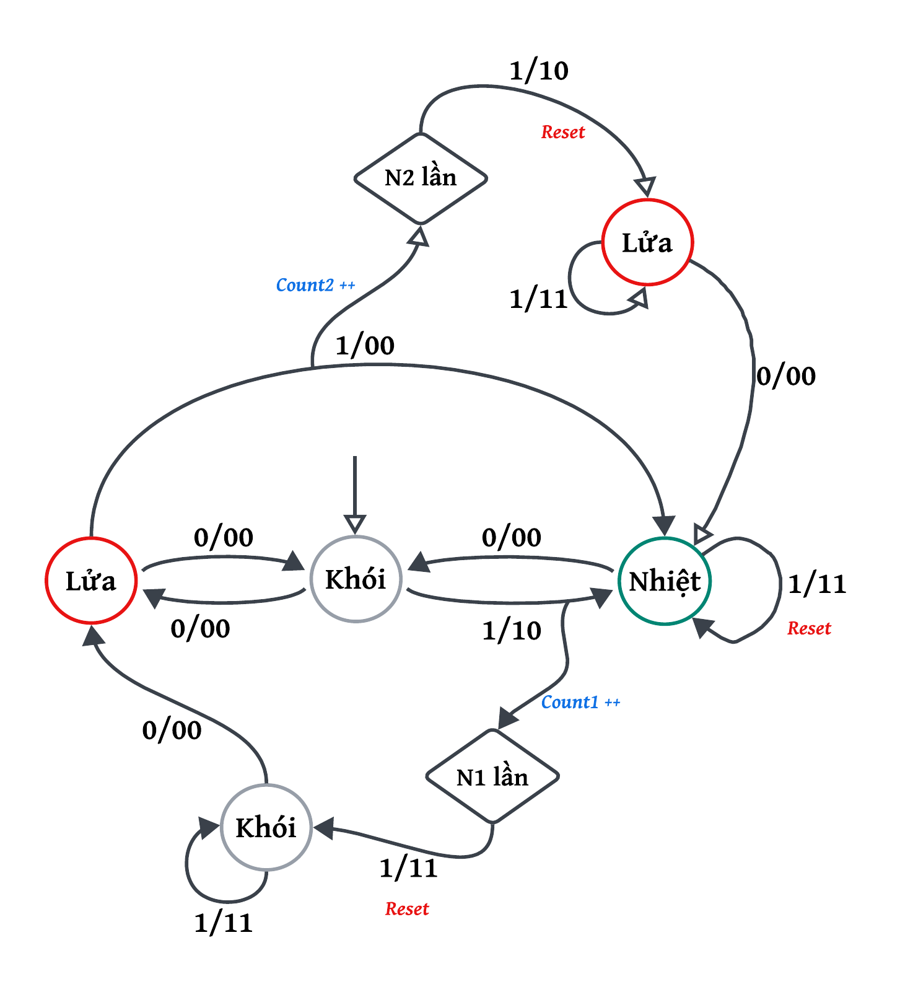
Finite State Machine
Consider the main fire situations
Burning flame:
The fire was small at first
No smoke detection capability
The temperature is not high enough for the system to detect
Fire in cold room:
The temperature is not high enough for the system to detect in cold environments
Fire is difficult to detect if it is a case of component fire
Gas tank explodes:
In this case the temperature increases
FSM

Slide 9
ZIGBEE NETWORK
Floor 3
F2 : Good
Floor 2
Floor 1
F2 : Error

Slide 10
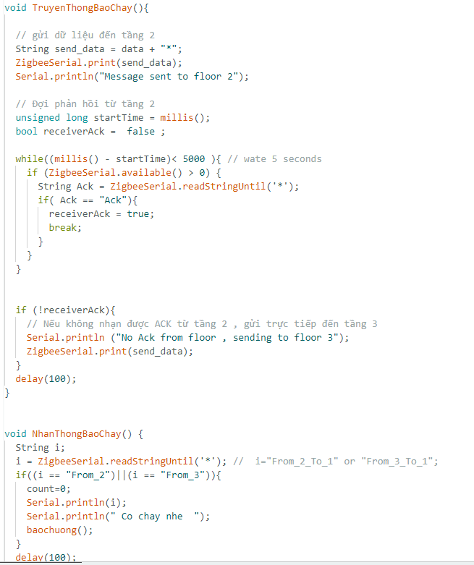
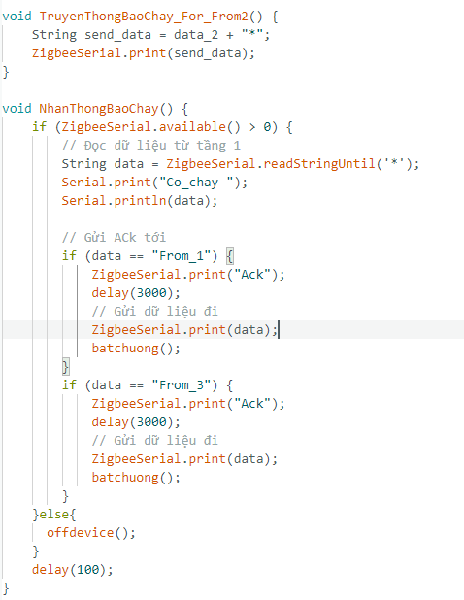
ZIGBEE NETWORK
Floor 1
Floor 2

Slide 11
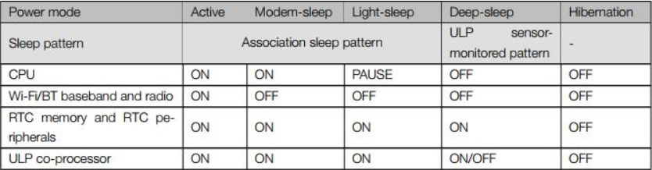
Optimizing energy for ESP32 in our system
- The ESP32 can switch between different power modes:
Active mode
Modem Sleep mode
Light Sleep mode
Deep Sleep mode
Hibernation mode

Slide 12
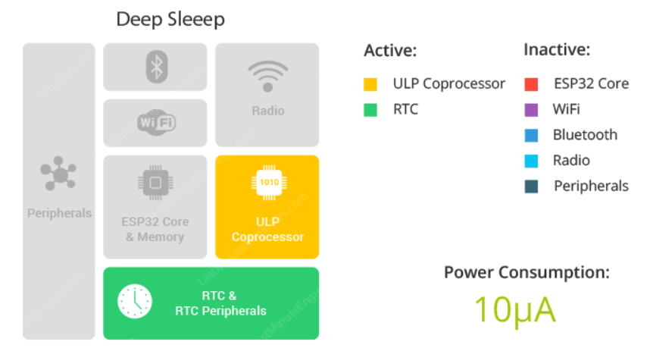
Why we choose Deep Sleep mode
Having your ESP32 running on active mode with batteries it’s not ideal, since the power from batteries will drain very quickly.
If you put your ESP32 in deep sleep mode, it will reduce the power consumption and your batteries will last longer.
While the ESP32 is in deep sleep mode the RTC memory also remains powered on, so we can write a program for the ULP co-processor and store it in the RTC memory to access peripheral devices, internal timers, and internal sensors.

Slide 13
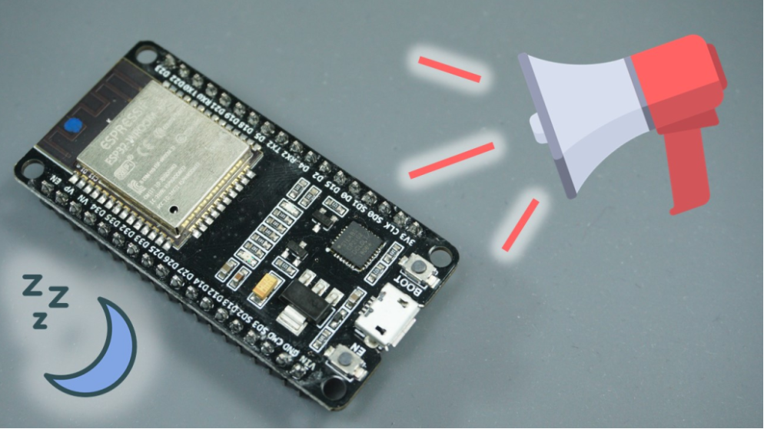
Deep Sleep mode in ESP32
Save data on RTC memory
With the ESP32, you can save data on the RTC memories. The ESP32 has 8kB SRAM on the RTC part, called RTC fast memory. The data saved here is not erased during deep sleep. However, it is erased when you press the reset button
ESP32 Deep Sleep Wake-up sources
Timer
Touch pad
External wakeup(ext0 & ext1)
=> In our system, we choose timer as wake-up source.

Slide 14
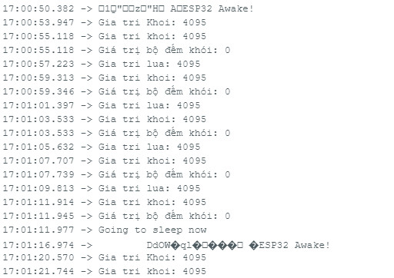
About Timer wake up from Deep Sleep in ESP32
The ESP32 can go into deep sleep mode, and then wake up at predefined periods of time. This feature is specially useful if you are running projects that require time stamping or daily tasks, while maintaining low power consumption.
In our system, ESP32 starts going to sleep and wake up after 5 seconds, then if none of the smoke, temperature and fire values reach the dangerous threshold ( for example, smoke<3500, temperature>33.5, fire<3200) within an amount of time then ESP32 will continue going to sleep.
But if there is any of 3 values reach the threshold, or there is fire alarms from floor 2 and floor 3, the system will immediately jump into loop for checking fire possibilities!

Slide 15
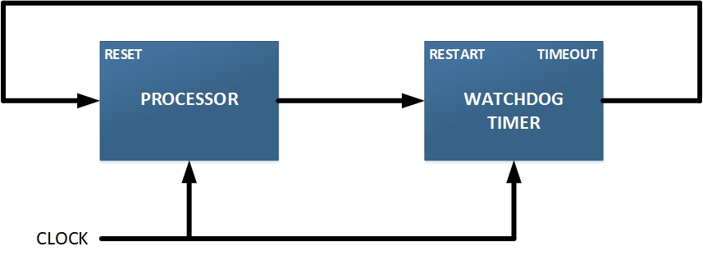

About watchdog timer in ESP32
A watchdog timer (WDT) is a timer that can be used to automatically detect software anomalies and automatically generates a system reset if the main program neglects to periodically service it.

Slide 16
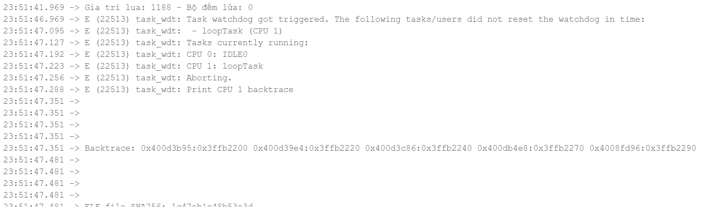
Using watchdog timer in our system
In our system, we use watchdog timer to prevent hang event may causes when the system has worked for a long time.

Slide 17
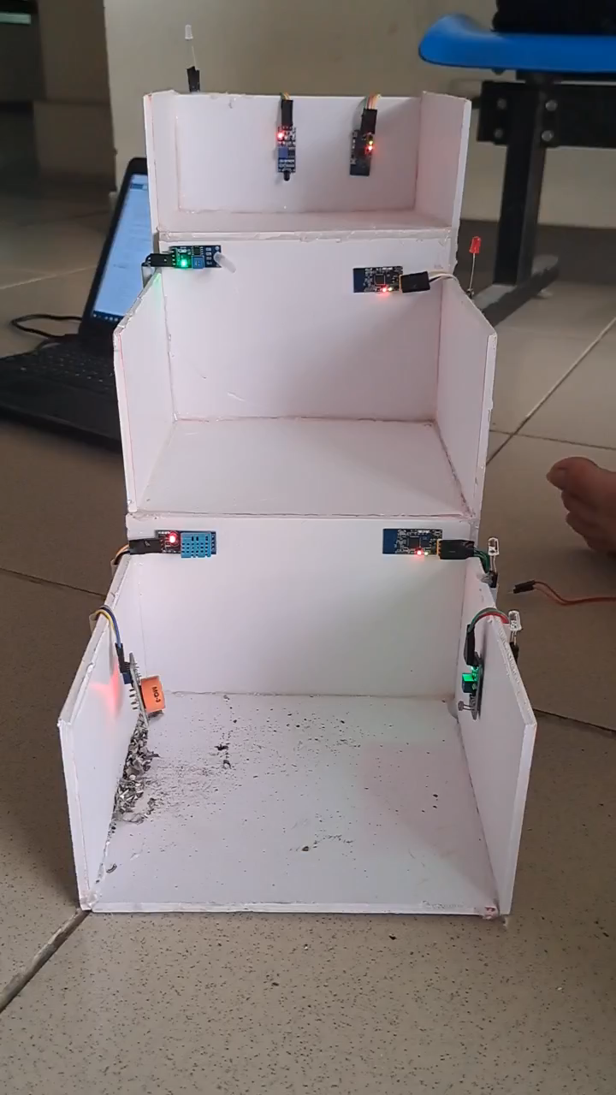
Results
Case 1: There is fire in floor 1

Slide 18
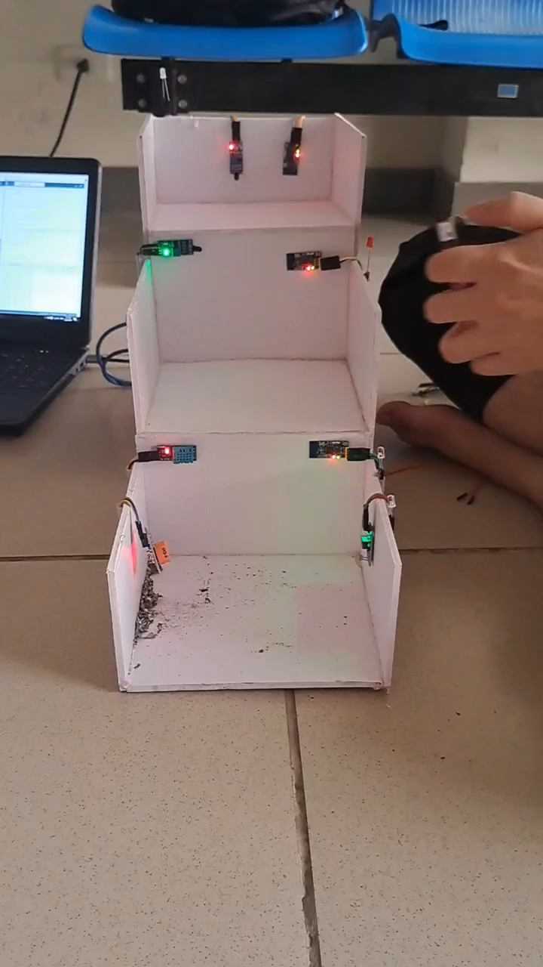
Results
Case 2: There is fire in floor 2

Slide 19
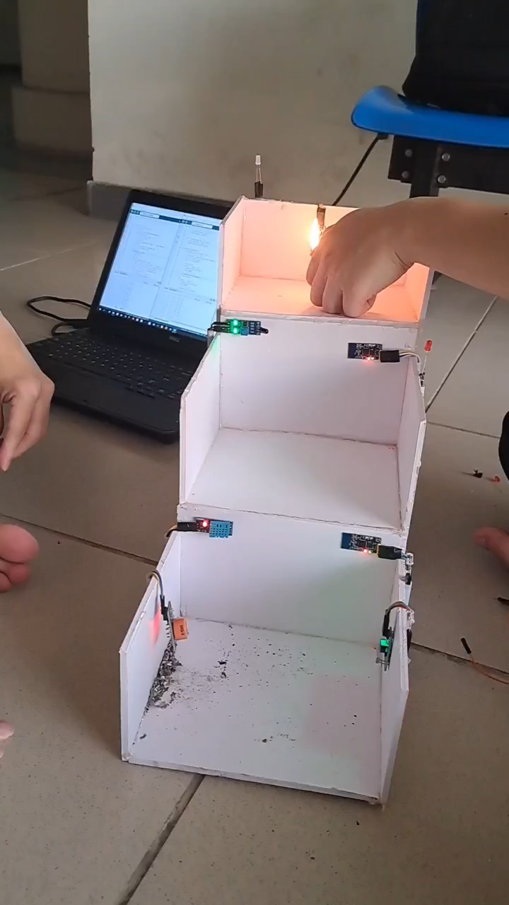
Results
Case 3: There is fire in floor 3

Slide 20
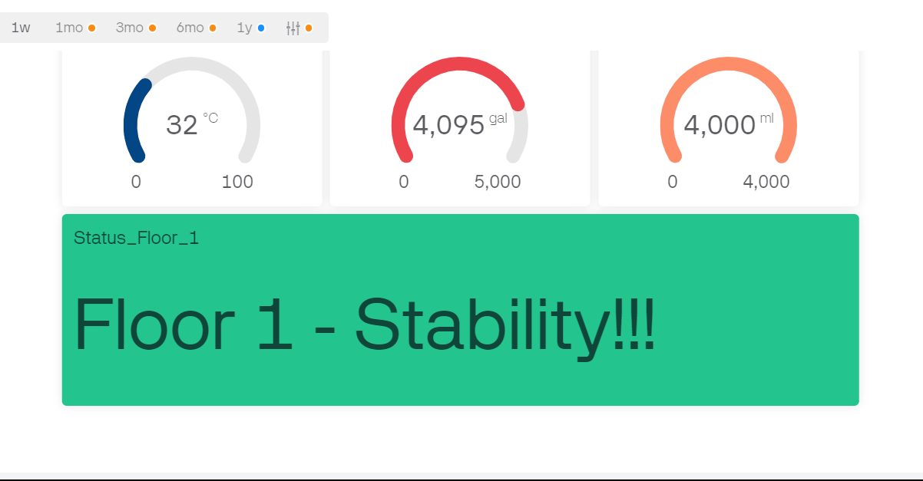
Display the data
Case: When the system meets nothing unusual, or when the system is in sleeping period.

Slide 21
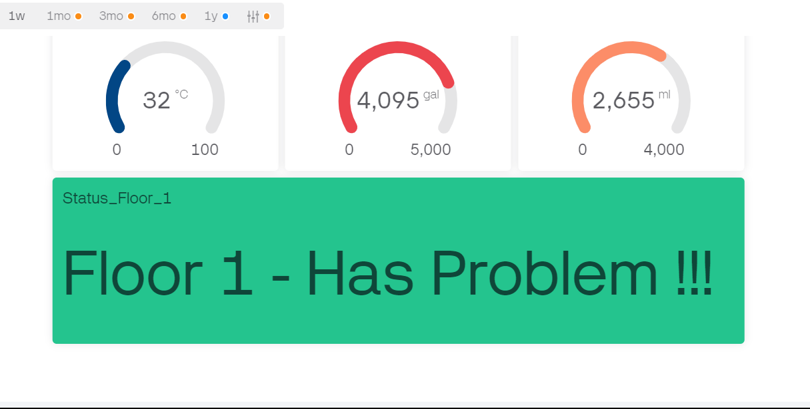
Display the data
Case: Floor 1 encounters unusual data from one of 3 sensors and start checking

Slide 22
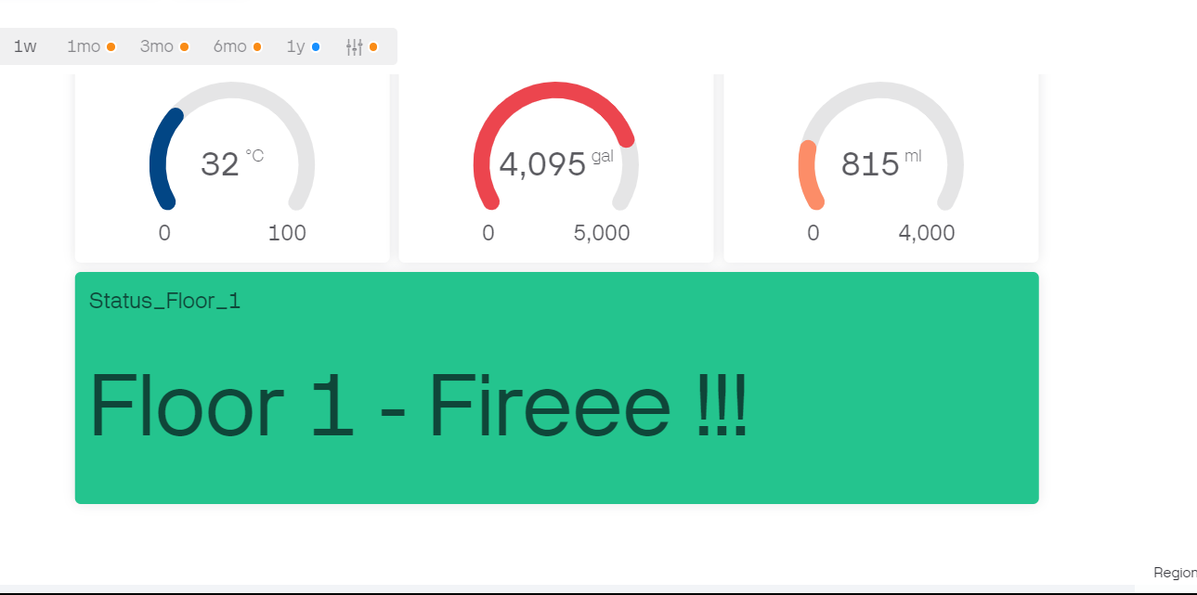
Display the data
Case: The floor 1 confirms there is fire in the building, then sends fire alarm to other floors and spray water

Slide 23
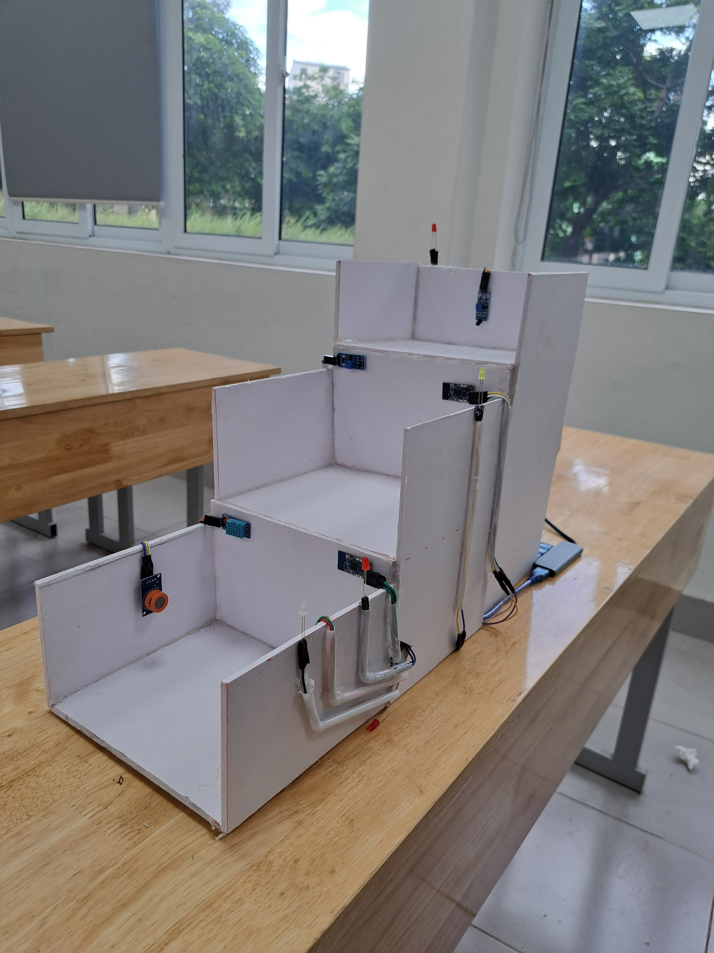
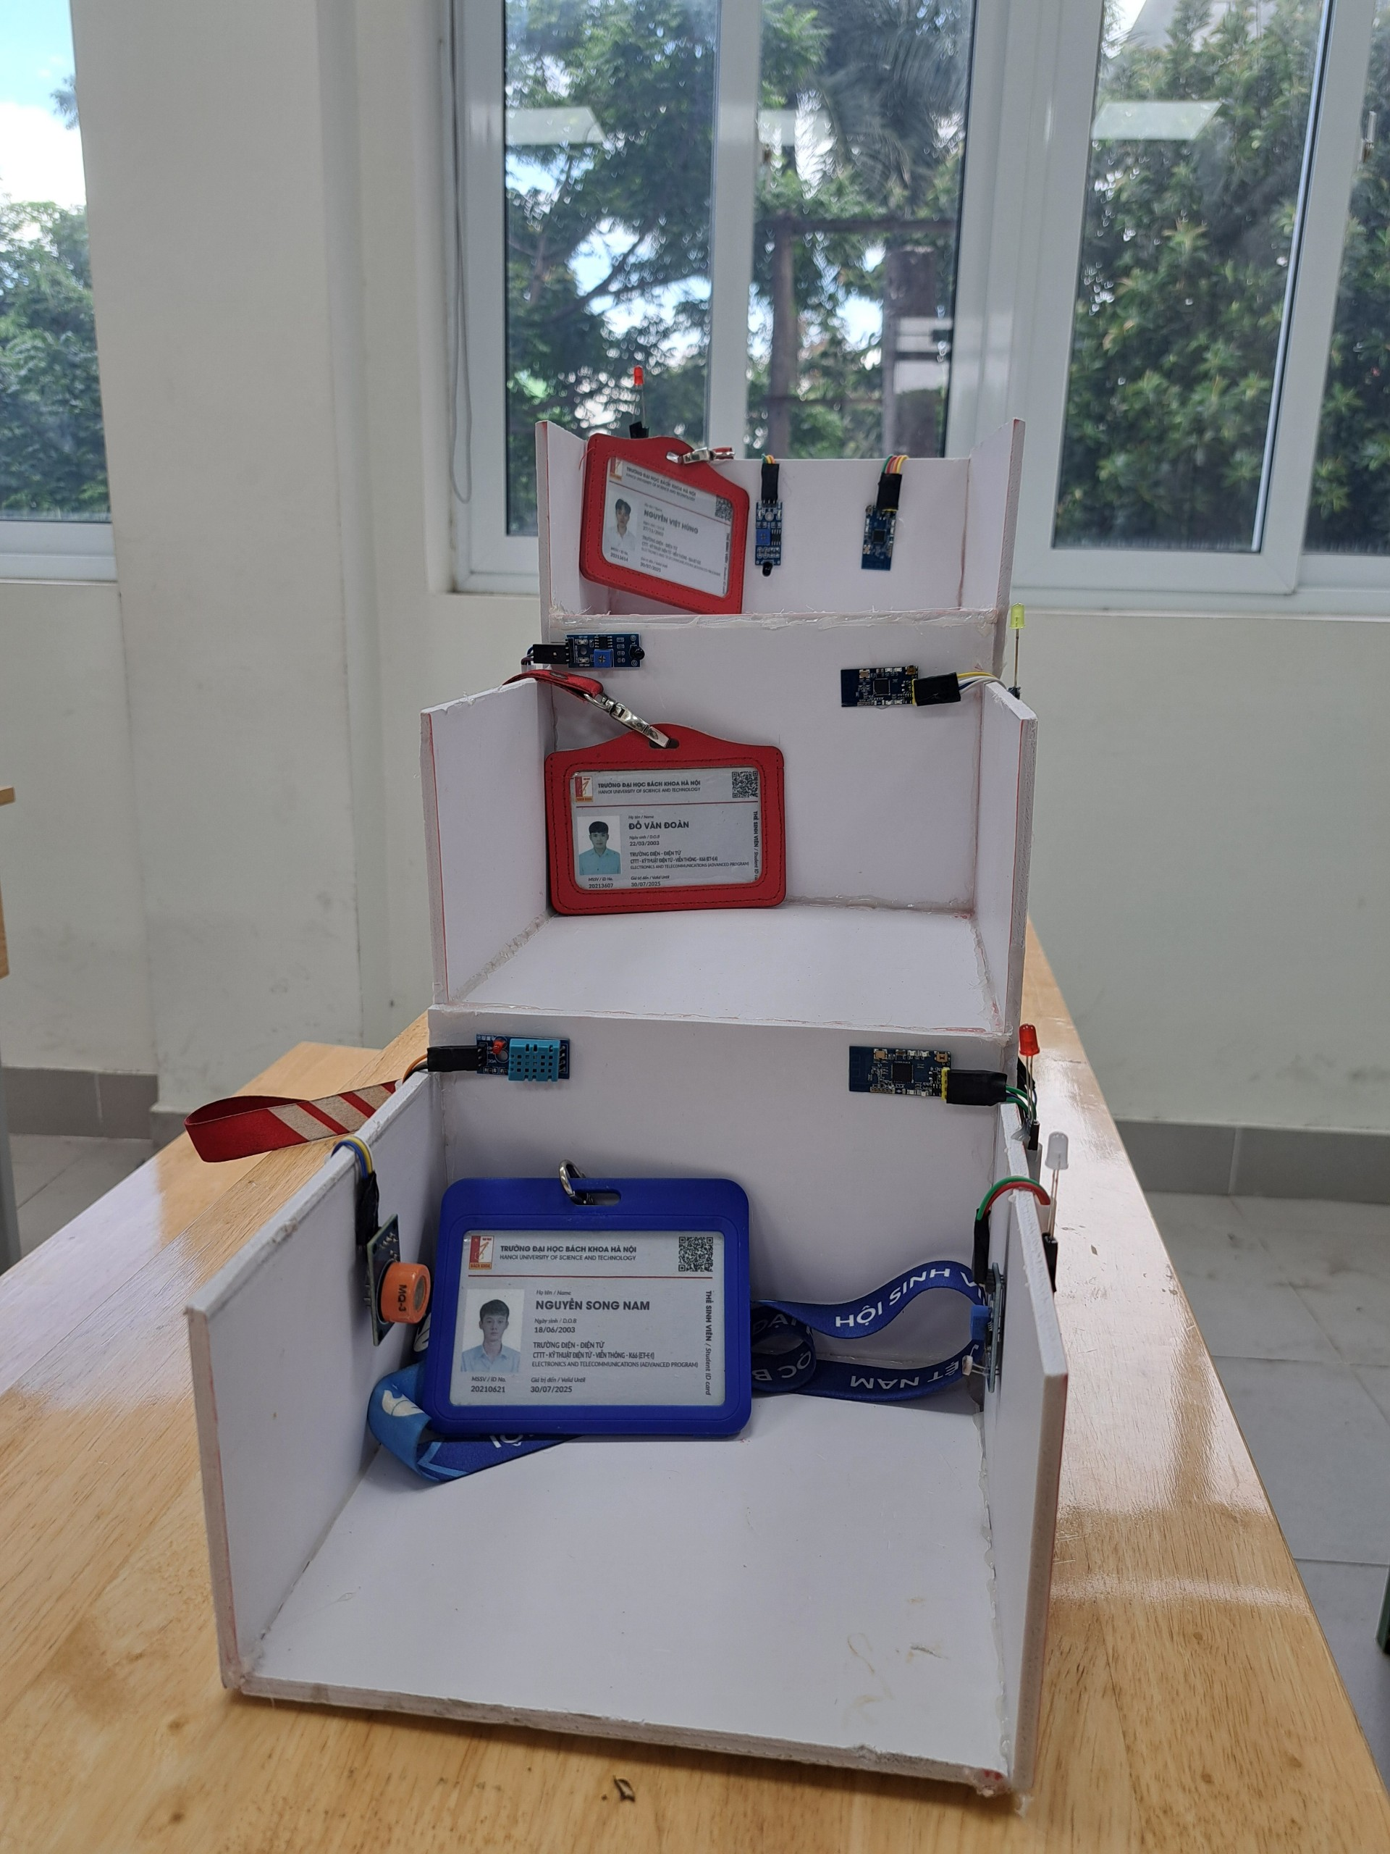
Hardware model

Slide 24
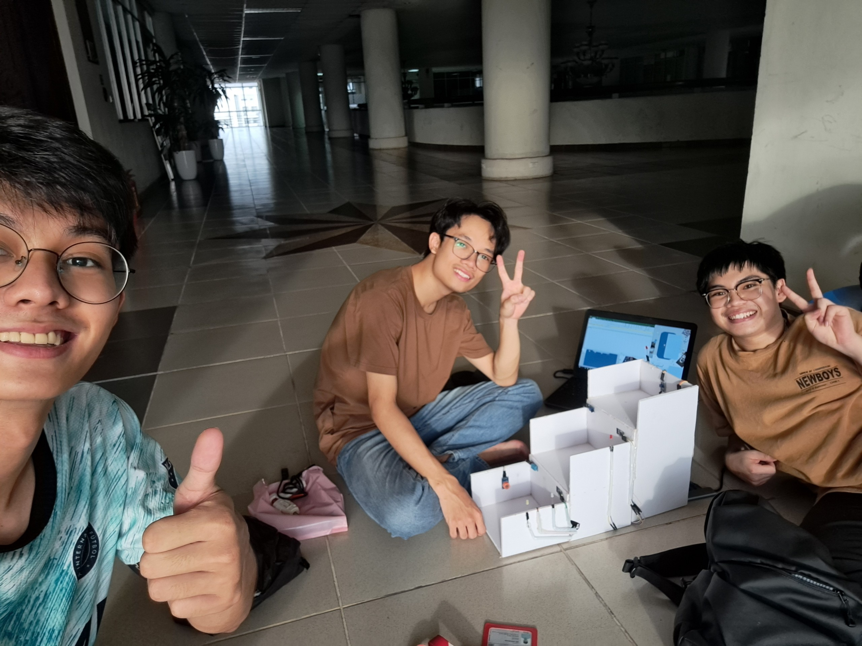
Teamwork moments

Slide 25
THANK YOU !

